Slide 1
Jumia Product Performance Dashboard
Analyzing Pricing, Discounts, and Customer Reviews
By Keffas Mutethia Nyamu

Slide 2
Project Overview
Objective: To analyze product performance using Excel dashboard
Dataset includes prices, discounts, reviews, and ratings
Key goal: Help Jumia identify trends and improvement areas

Slide 3
Data Cleaning & Enrichment
Removed duplicates guided by the product type column.
I replaced the empty cells in Ratings with the average rating values of 3.8 and empty cells in reviews with average of 12
Converted prices and ratings to numeric format
Created:
Absolute discount Amount column
Product Rating categories: Poor, Average, Excellent
Discount percentage categories: Low (<20%), Medium (20–40%), High (>40%)

Slide 4
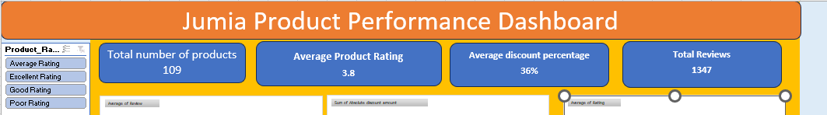
Descriptive Statistics
Average Current Price: KSh 1,195.05
Average Old Price: KSh 1,822.16
Average Discount: 36%
Average Rating: 3.8
Most Expensive:32PCS Portable Cordless Drill Set with Cyclic Battery Drive -26 Variable Speed
(KSh 3,750)
Least Expensive: 3PCS Single Head Knitting Crochet Sweater Needle Set KSh 38

Slide 5
Rating & Discount Categories

Slide 6
Trend Analysis – Discounts vs Reviews
Correlation: -0.06841 → very weak negative relationship
Higher discounts slightly reduce review numbers
Impact is negligible

Slide 7
Trend Analysis – Ratings vs Reviews
Correlation: 0.05921 → very weak positive relationship
Higher ratings slightly increase review numbers
Still not a strong predictor

Slide 8
Top Rated Products
Top 5 Products | Rating
Konka Healty Electric Kettle, 24-hour Heat Preservation,1.5L,800W, White | 5
LASA Aluminum Folding Truck Hand Cart - 68kg Max | 5
DIY File Folder, Office Drawer File Holder, Pen Holder, Desktop Storage Rack | 5
Bedroom Simple Floor Hanging Clothes Rack Single Pole Hat Rack - White | 5
Anti-Skid Absorbent Insulation Coaster For Home Office | 5

Slide 9
Low Rated Products
Product | Rating
Artificial Potted Flowers Room Decorative Flowers (2 Pieces) | 2.2
7-piece Set Of Storage Bags, Travel Storage Bags, Shoe Bags | 2.2
5-PCS Stainless Steel Cooking Pot Set With Steamed Slices | 2.1
Electric LED UV Mosquito Killer Lamp, Outdoor/Indoor Fly Killer Trap Light -USB | 2.1
Wall-mounted Sticker Punch-free Plug Fixer | 2

Slide 10
Top 10 products with the highest Discounts

Slide 11
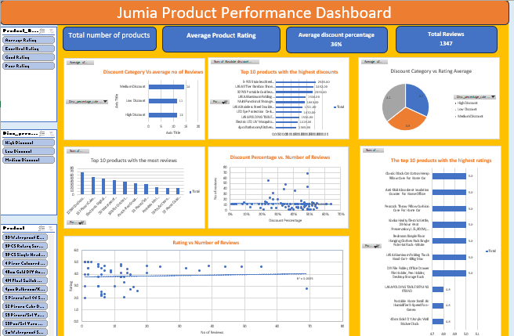
Dashboard Demo & Recommendations
Interactive Excel dashboard includes slicers, charts, and KPIs

Slide 12
Conclusion
Jumia can:
Focus on medium discounts for better engagement
Investigate low-rated but popular products
Use customer reviews as feedback for improvements

Slide 13
Thank You

